Slide 1


Investigator+ meeting
19 March 2026 www.epicaremh.org
The national early psychosis platform

Slide 2

Welcome
Housekeeping
The vision & need for EPICare
Objectives of the day
Program
Ways of working
Key people

Slide 3
Our vision for EPICare
“To build a national digital platform that uses data donated by people with psychosis in England to improve treatment, support, recovery and other outcomes that matter to people with psychosis”

Slide 4

An introduction to EPICare

Slide 5
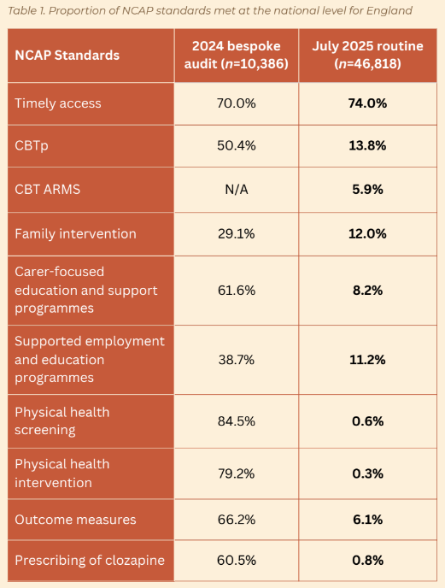
The need for EPICare
Data saves lives (NHS England, 2024)
Current ways of using routine data from people with psychosis does not support evidence-based decision-making at the individual, service, Trust or national policy levels
Problems include:
  Timely flow of data back to people with psychosis and clinicians
  Poor quality data, including missing, inaccurate or infrequently collected data
Only about 30-40% of people with first episode psychosis (FEP) make a full recovery
Treatments and outcomes vary by sociodemographic and geographic factors, creating inequalities in care and recovery
Moving from analogue to digital data, used intelligently, could revolutionise offer of the right treatments, to the right people at the right time

Slide 6
The need for EPICare
In other health areas, like stroke, cancer or cardiovascular disease, national registries have transformed care
This is completely missing for mental health
Developing, implementing, evaluating and upscaling EPICare nationally could improve care and recovery, while putting investment in psychosis intelligence on a par with physical health outcomes

Slide 7
Objectives of the day
To come together as a set of stakeholders interested in supporting the EPICare platform
To recognise and refine a shared vision for EPICare
To develop a shared understanding of the need for EPICare, how it works, and how to work together most effectively to overcome key issues

Slide 8
Program
11:10 Brief introduction activity
11:20 Introduction to EPICare & progress updates
11:50 Breakout session 1: Understanding our ecosystem (stakeholder mapping)
12:20 Breakout session 2: Developing our shared purpose (world café)
13:00 LUNCH (including dashboard demos, poster walk)
14:00 Breakout session 3: Key issues deep-dive
15:00 TEA BREAK
15:15 Plenaries
16:15 Reflections from the room & next steps
16:30 CLOSE

Slide 9
Ways of working
We are a very diverse set of stakeholders; our strength lies in this diversity
This diversity helps ensure as many perspectives as possible shape the work we do
As we discuss issues around EPICare today, we encourage adoption of a set of shared values of respect, curiosity and collaborative learning as we discuss the EPICare platform
We welcome challenge, disagreement and counter views within this environment
Please be mindful of others around you
Use lay language where possible, and ask for clarifications
Taking breaks, stepping out, etc are all acceptable and expected
We welcome your feedback!

Slide 10

Brief activity
On your tables, spend 5-6 minutes introducing yourselves to each other. Please ask and answer the question “What brings you here today?”
Once you have an answer. please submit it in 2-3 words (or fewer) to our Menti:
www.menti.com/alohvzh29g13

Slide 11
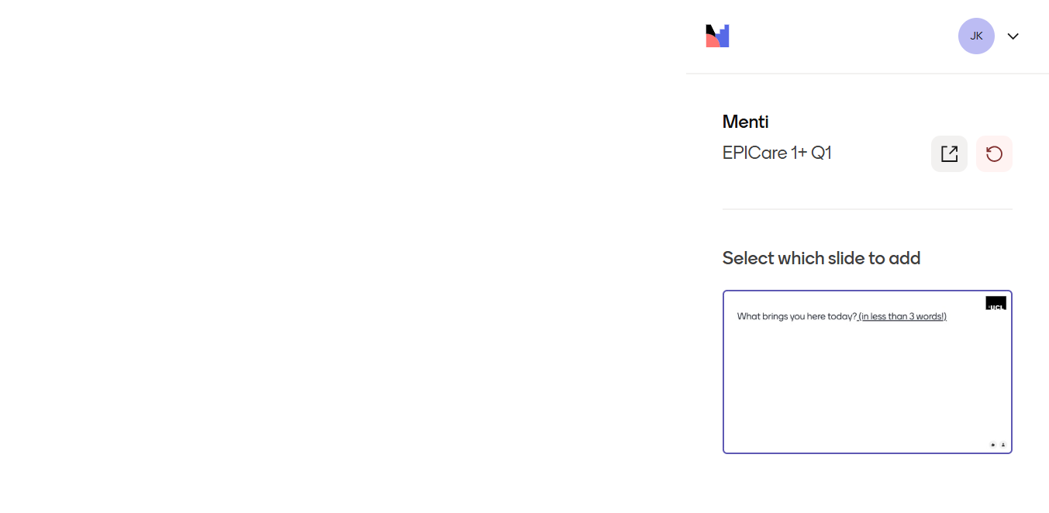
Brief activity
On your tables, spend 5-6 minutes introducing yourselves to each other. Please ask and answer the question “What brings you here today?”

Slide 12
11:20–11:50 — Introduction to EPICare & progress updates

Slide 13
11:20–11:25 EPICare overview & progress updates (Rachel Upthegrove)

Slide 14
















Slide 15

Rationale: Although Early Intervention in Psychosis (EIP) services are nationally mandated to provide multidisciplinary care to people experiencing first-episode psychosis, only 30-40% of people experiencing psychotic disorders make a full recovery, with wide individual and regional variations in care offered and received.
Aim: Improve national, local, and individual clinical decision-making and promote more equitable, timely delivery of evidence-based interventions to transform patient outcomes and reduce population-level disparities in care via a co-designed digital psychosis registry (the EPICare core dataset) and Clinical Dashboard.

Slide 16
The EPICare project: overview
Stakeholder co-development
Development & implementation
Scientific evaluation
National rollout
Phase 1
Phase 2
Phase 3
Phase 4
Oct 21 – Sep 22
Feb 23 – Jan 28
May 25 – Apr 29
(RiO integration)
May 29 +
Programme Development Grant
Mental Health Mission
Programme Grant for Applied Research

Slide 17



What is
EPICare is a co-designed digital platform that uses routine data collected from patients in Early Intervention Psychosis services in England to provide real-time insights to help clinicians & services improve patient care and outcomes
The EPICare platform consists of three inter-related components:
Clinical dashboard
Core dataset (registry)
Secure Data Environment
Electronic Health Record
NHS firewall
Patient smartphone app
Secure app

Slide 18
What data is collecting?
Demographic factors
Treatment measures
Outcome measures
Age at referral
NICE Access & Waiting Time Standard Treatment Indicators
Timely Access: Time from referral to start of treatment (2-week target)
Cognitive Behavioural Therapy for Psychosis (CBTp): Offer
Family Interventions: Offer
Clozapine: Offered – Offer (after 2+ inadequate responses to other APs)
Supported Employment/Education: Receipt (inc. decline)
Physical Health Assessments (annual): Smoking/Alcohol/Substance misuse/BMI/Blood Pressure/Glucose/Cholesterol
Physical Health Interventions: Needing interventions (yes or no); Interventions Offered (Combined health eating & physical activity programmes; smoking cessation; interventions for people with rapid/excessive weight gain, abnormal lipid levels or problems with glucose management)
Carer Education and Support: Offer
DIALOG
Sex
GBO
Gender
ReQoL
PROMs
Ethnicity
QPR
LSOA (postcode)
PANSS
(self-report )
SSST
Cognitive
task
Marital status
HoNOS
Employment status
CROMs
CGI-SCH
Accommodation type
Existing in EHR
New for EPICare
Notes:
PROMs and CROMs to be collected at least every 6 months. Those in green shading are new ones added by EPICare, all others are existing EHR items

Slide 19




The EPICare project: Organisations
Sponsor
Academic lead (implementation)
PGfAR host
Academic lead (evaluation)
Participating NHS EIP sites
RiO EHR
May 29 +
Development & implementation
Scientific evaluation
National rollout
Phase 2
Phase 3
Phase 4
Early adopter

Slide 20
Progress update & challenges
Up and running in 2 NHS trusts fully (Birmingham & Nottinghamshire)
Clinical dashboard being used in clinical practice, with positive feedback
Anticipate onboarding three further sites in next 6 months, with RiO integration allowing further national rollout
Engaged Lived Experience Advisory Group, influencing implementation decisions
Engaged with Trusted Research Environment provider (DATAMIND) to house registry data
Governance challenges
PROM data integration
Harmonisation of technical coding to align to a national standard for psychosis data collection

Slide 21
11:25–11:30 EPICare scientific aims (Lowri Griffiths)

Slide 22
Scientific Aims
Key Scientific Questions
To evaluate the implementation, clinical- and cost‑effectiveness of the EPICare psychosis platform and clinical dashboard to generate actionable insights that improve:
Equitable access to timely, evidence‑based treatment
Patient outcomes
EIP service delivery
Are people in EIP offered and receiving NICE‑recommended standards of care?
Do offers or receipt of care vary by ethnicity, gender, age, employment or socioeconomic context?
Are NICE‑recommended treatments associated with improved PROMs and CROMs in real‑world practice?
Does the clinical dashboard improve fidelity to NICE standards and reduce inequalities in care?
Does improved fidelity to evidence‑based care translate into improved patient outcomes?

Slide 23
Key Evaluation Themes
Accurate, reliable, consistently recorded data.
Data Quality
Implementation
Clinical Effectiveness
Cost
Effectiveness
Acceptability,
barriers & facilitators.
PPIE
Fidelity to NICE standards.
Inequalities in care.
Real‑world treatment effectiveness.
Cost‑effective compared with treatment‑as‑usual?
Notes:
Our research focuses on four key themes: data quality, implementation, effectiveness, and cost-effectiveness with PPIE at the core of this work. We want to know if EPICare provides accurate and reliable data, how acceptable and feasible it is to implement, whether it can track fidelity, inequalities, and treatment outcomes, and whether it offers better value compared to current practice.

Slide 24
11:30–11:35 Dashboard demonstration – Nottingham (Clement Owuamalam)

Slide 25
11:35–11:40 Dashboard demonstration – RiO integration (Charles Waddington)

Slide 26


Renold Building
81 Sackville Street
Manchester
M1 3NJ
contact@careloop.health

Slide 27
5 minute overview of;
• EPICare Dashboard – RiO integration
• Early Intervention MH Mission App – EPICare Dashboard / RiO integration
Charles Waddington
Principal Software Engineer

Slide 28
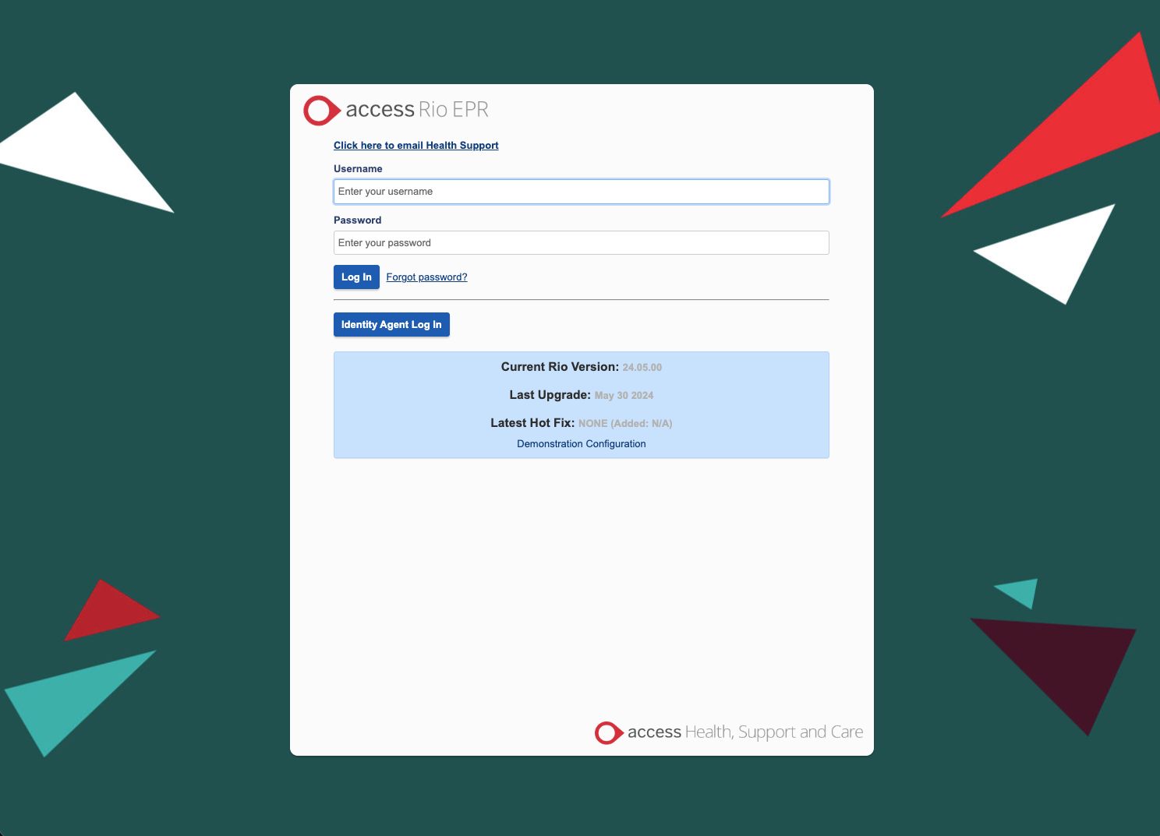
The EPICare dashboard has been integrated with RiO.
CareLoop worked with The Access Group to bring this implementation to completion.

Slide 29
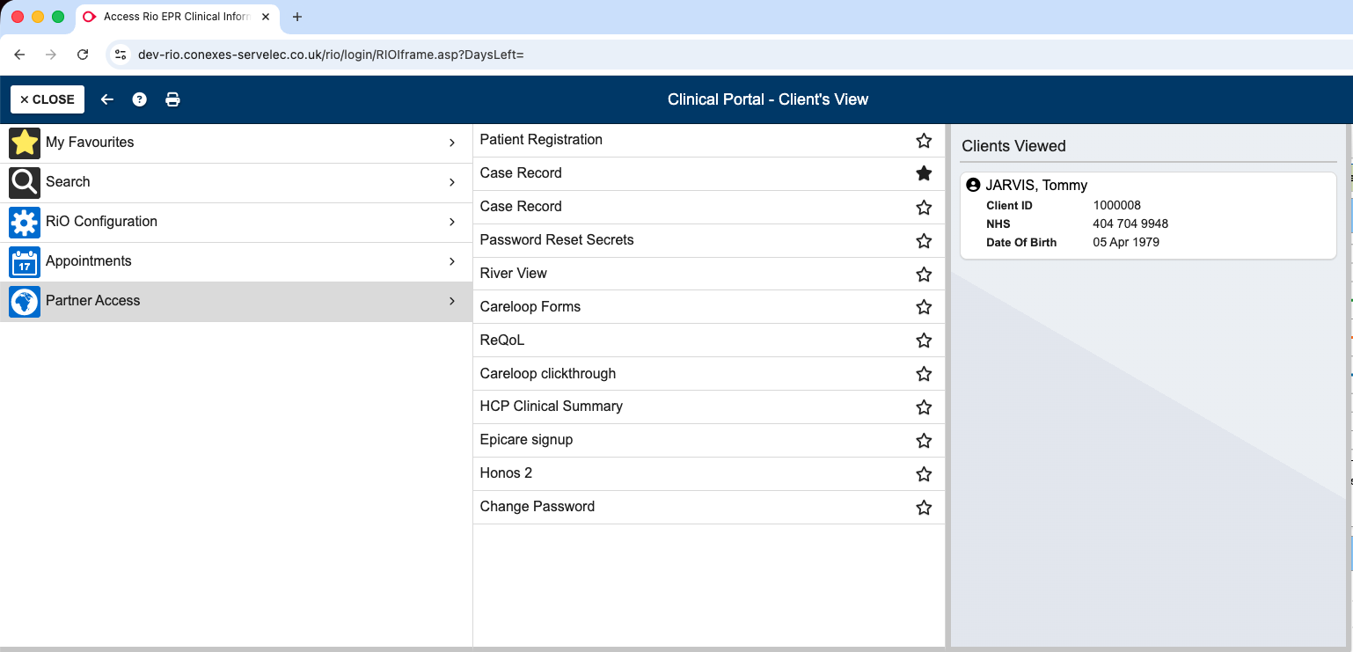
HCP selects Case Record.

Slide 30
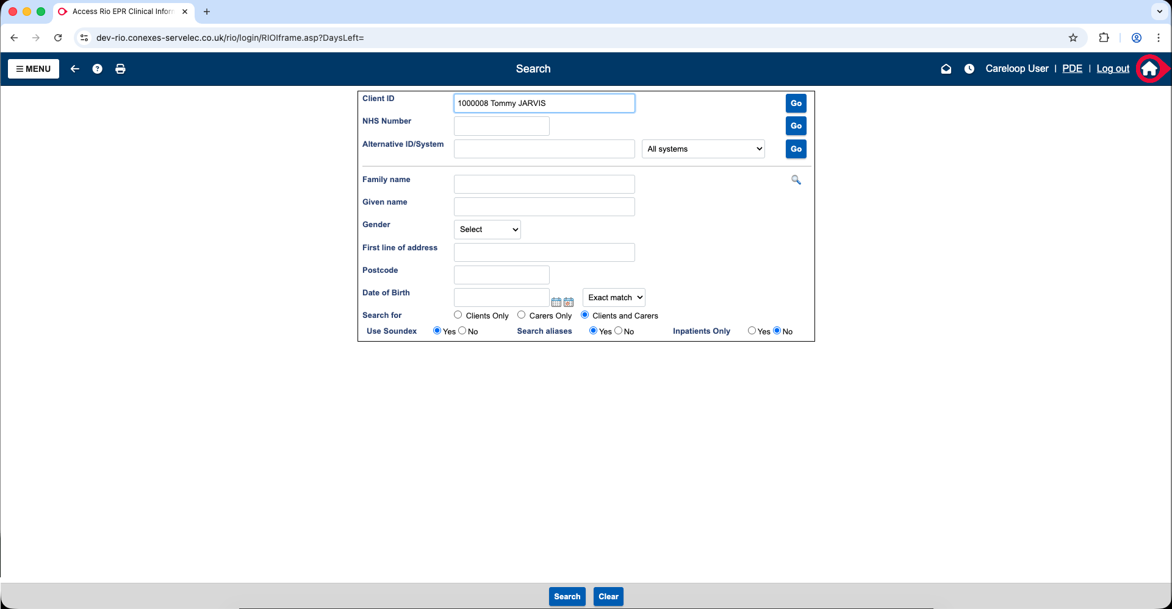
Search page used to select Service User.

Slide 31
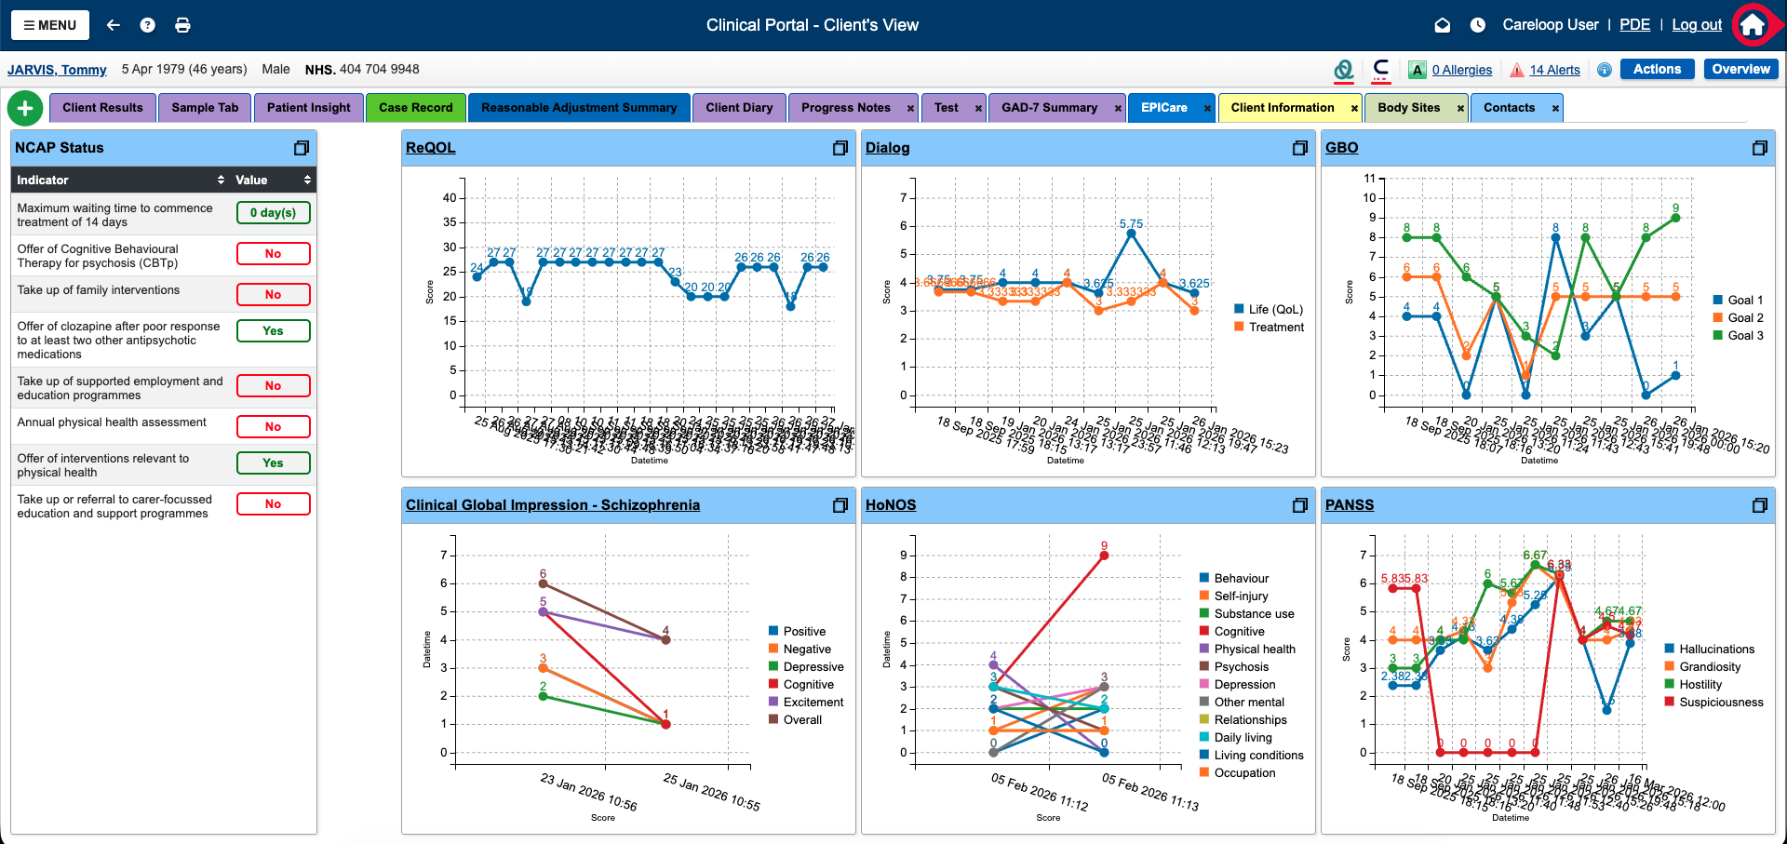
EPICare Dashboard Showing;
• NCAP Status.
• Graphs of HCP/Service User submitted data from sources such as EPICare App, Trust Apps, RiO.

Slide 32
Each section can be maximised by clicking the button in the top right.

Slide 33
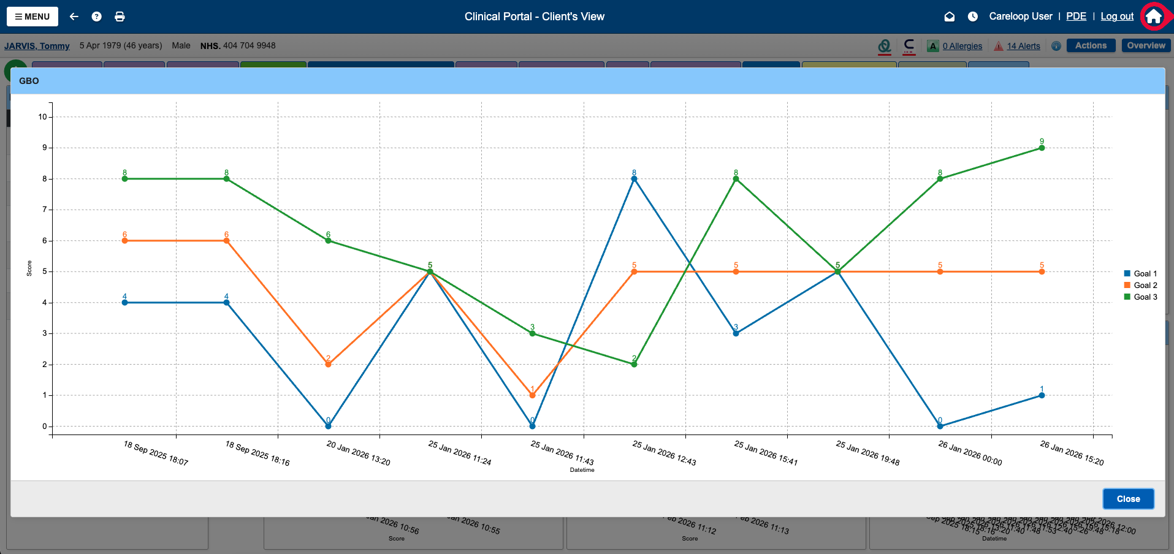
In this case the HCP clicked GBO top right, which allows the dates to be more easily accessible.

Slide 34
Clicking the title of the graphs allows data entry and correction.

Slide 35
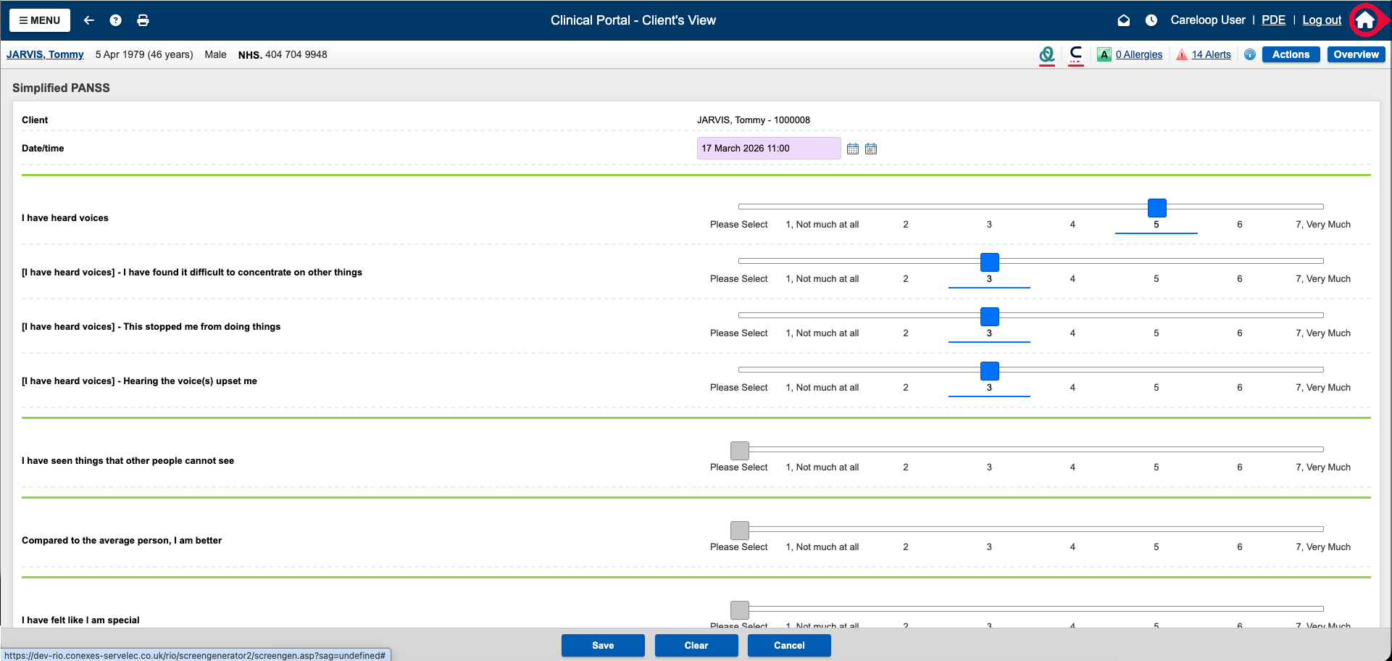
In this case the HCP clicked PANSS allowing data entry/editing.

Slide 36
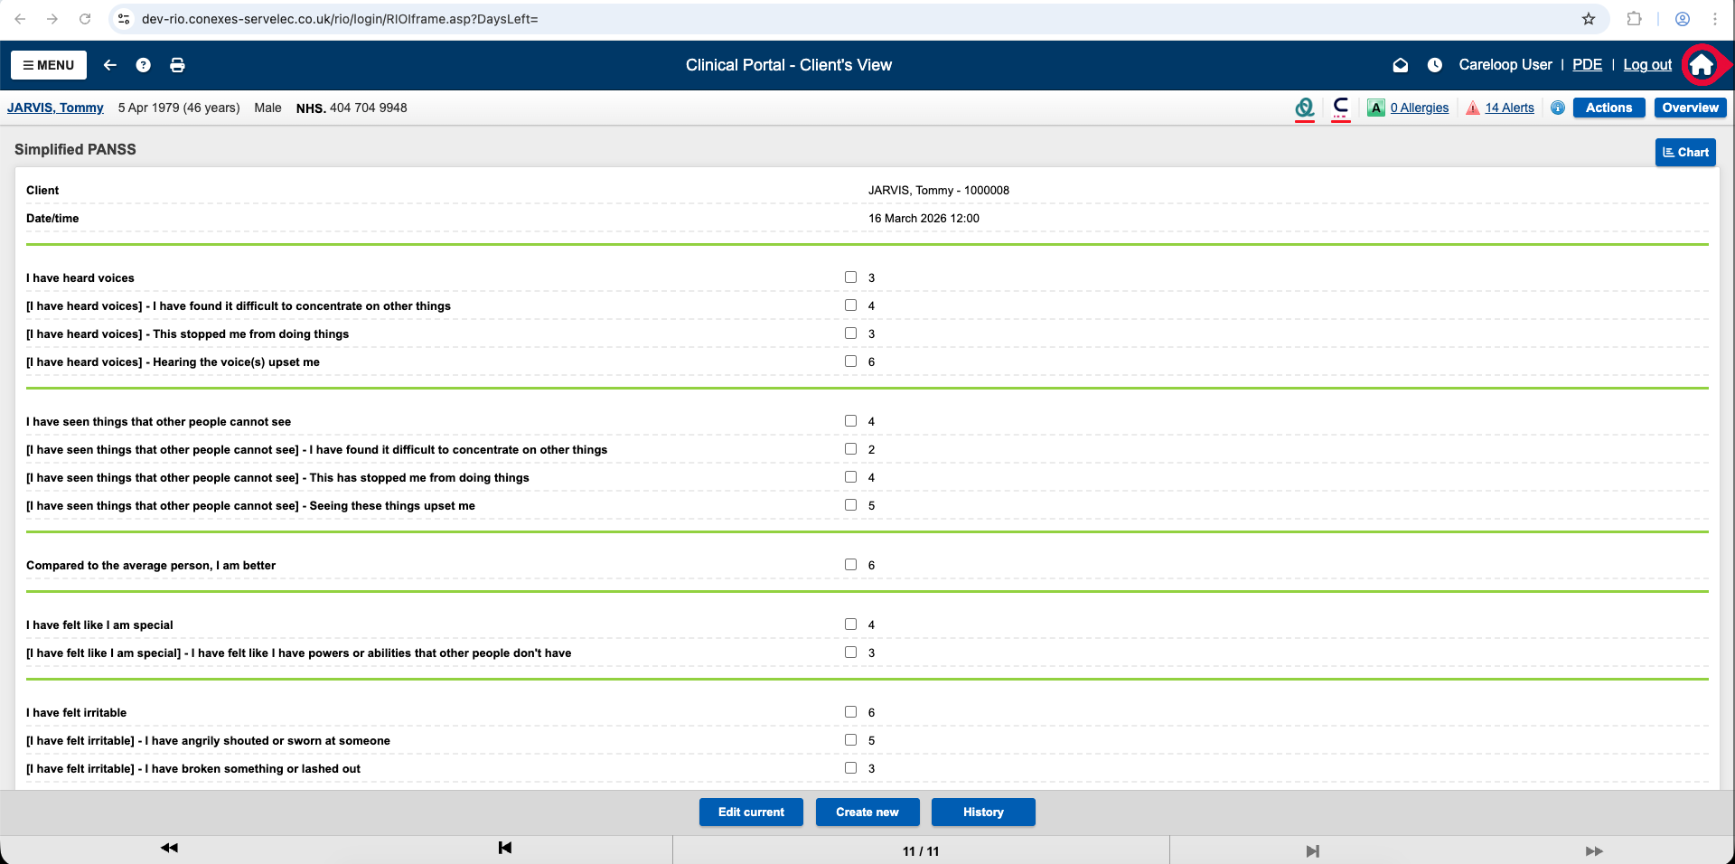
Benefits of using EPICare Dashboard
Integrated into existing RiO system, one of the biggest EPRs in the country.
Familiar interface for Providers.
Clear NCAP Status.
Graphs showing data from multiple sources
  EHR
  Existing Apps
    Trust Apps
    Early Intervention MH Mission App

Slide 37
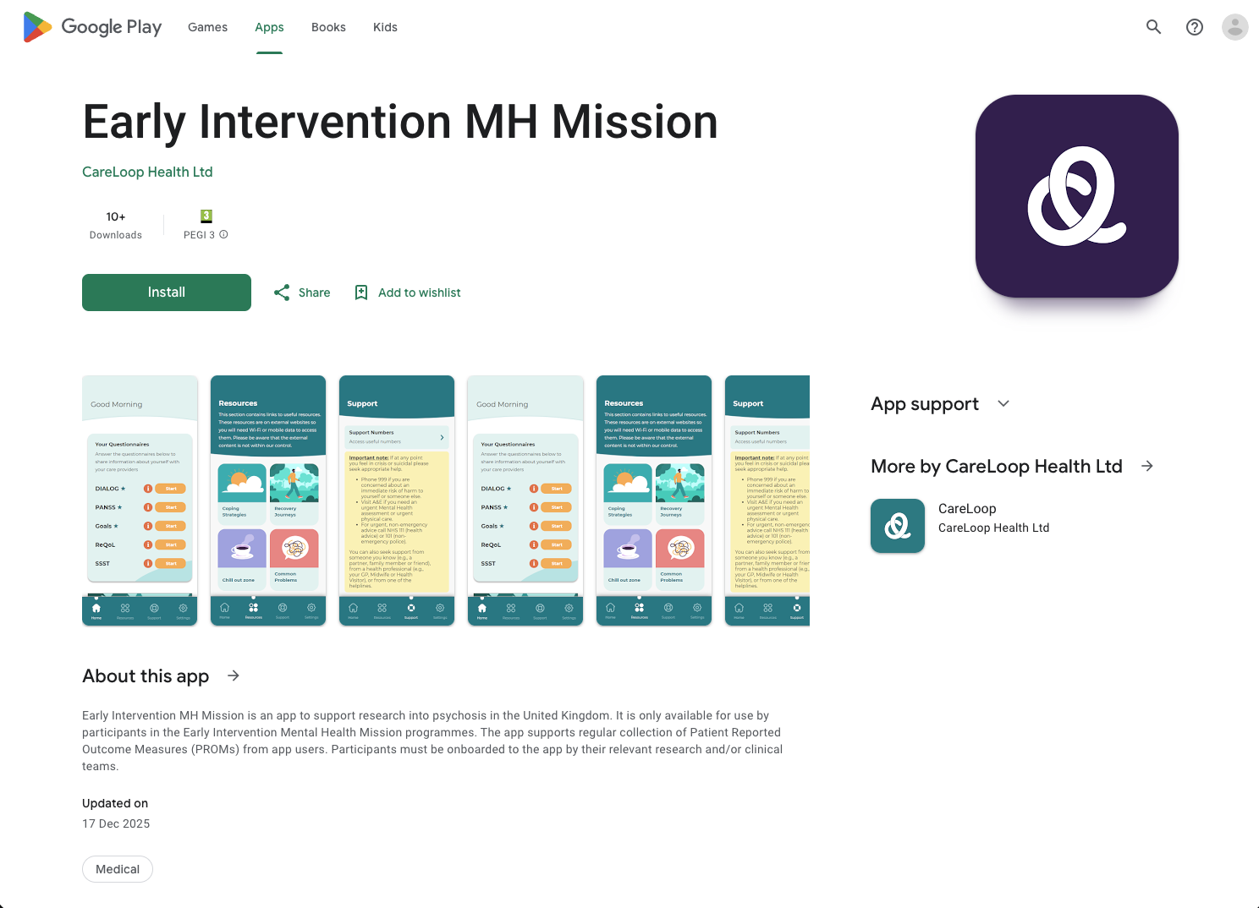
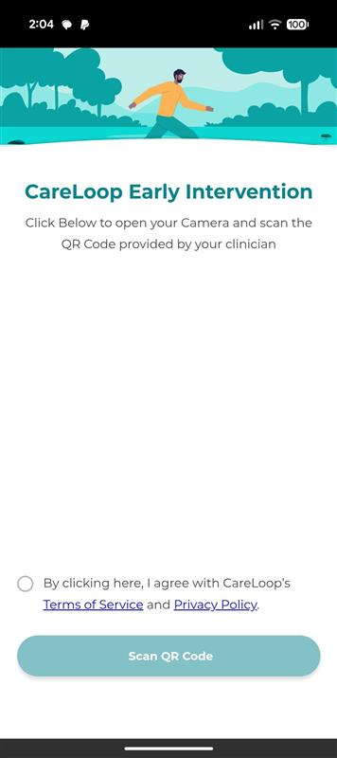
App Store / Download / Onboard / Updates

Slide 38
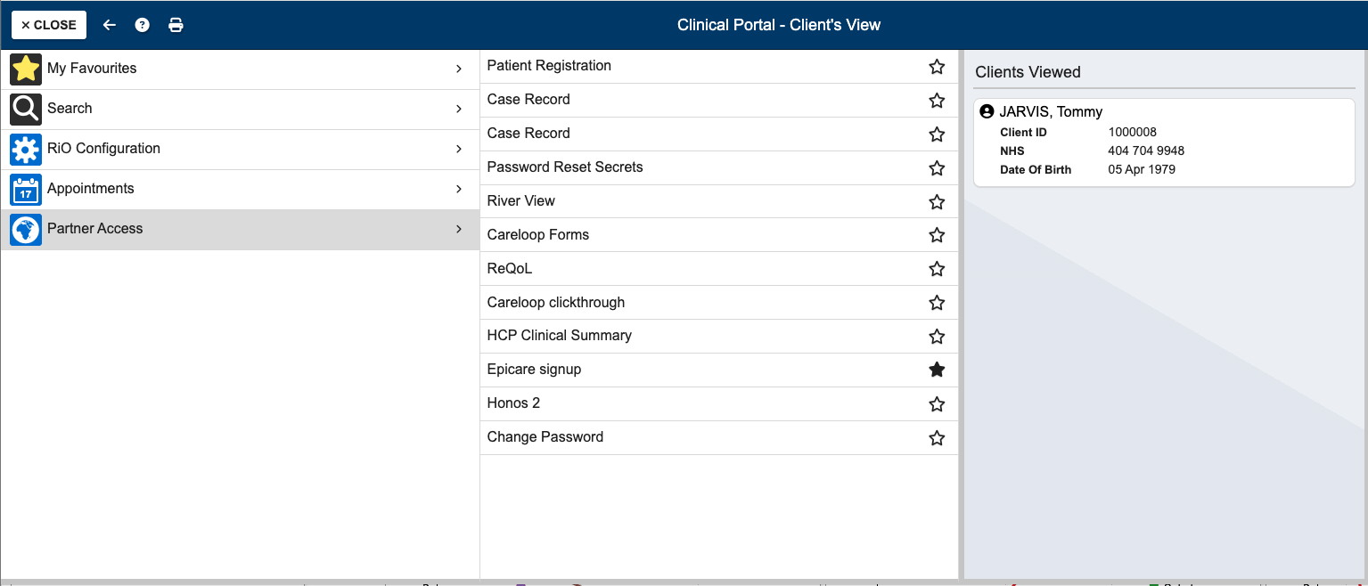
Onboarding a Service User so they can use the App.

Slide 39
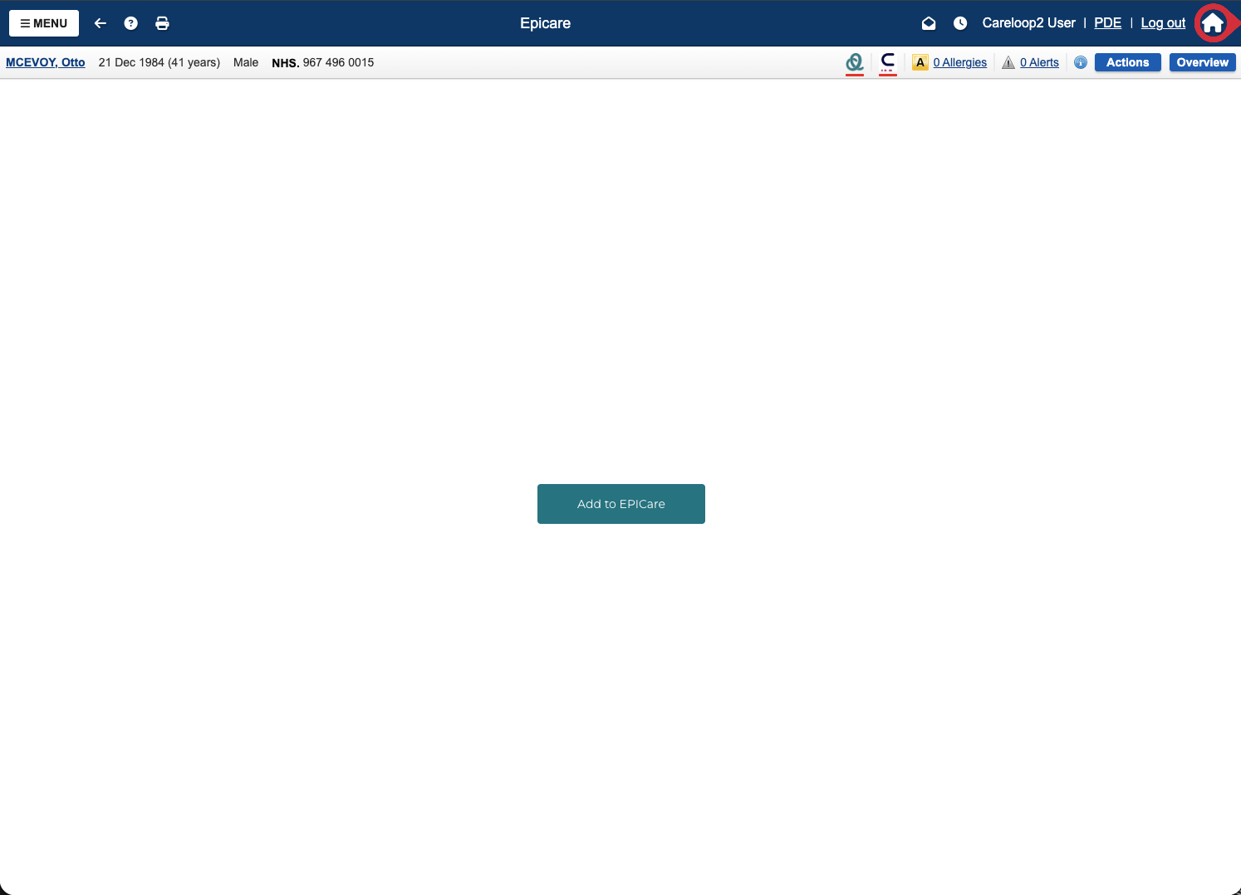
Onboarding a Service User with a simple click.

Slide 40
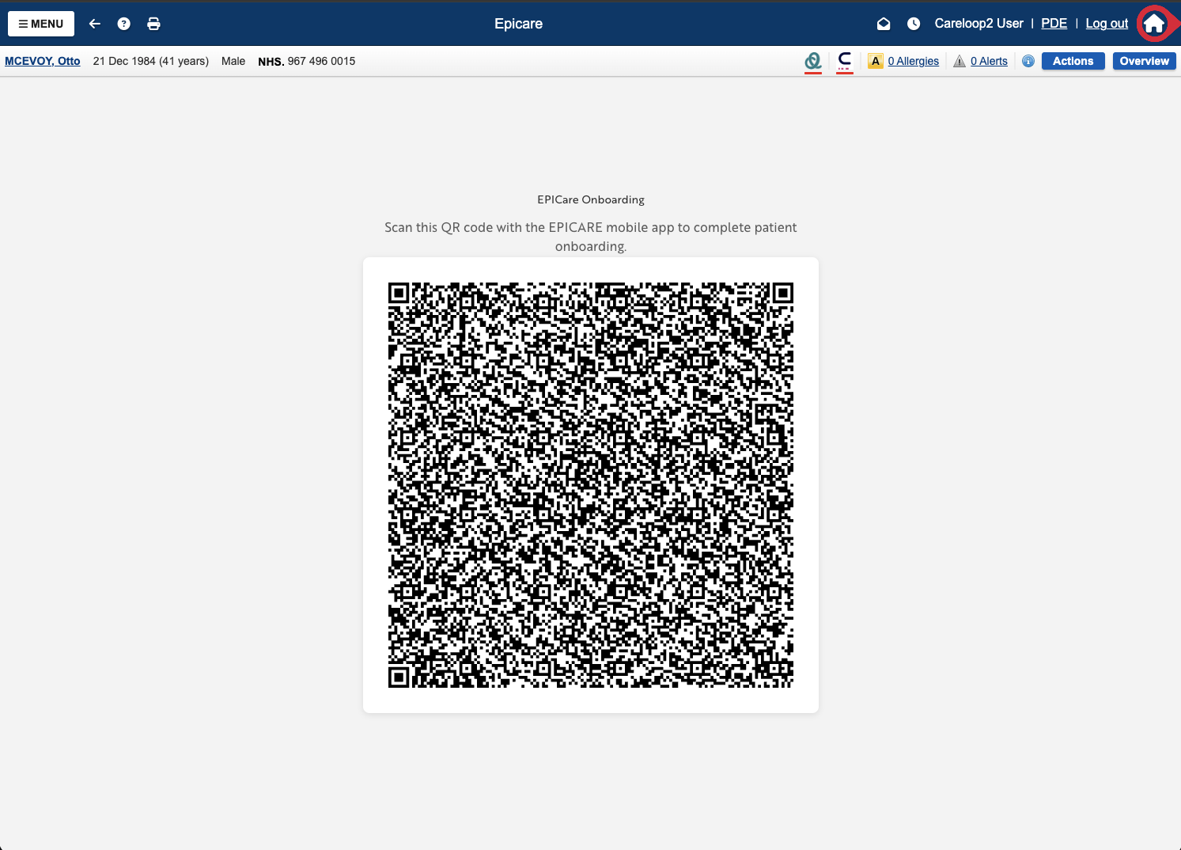
Scan the code with the app to connect the Service User.

Slide 41
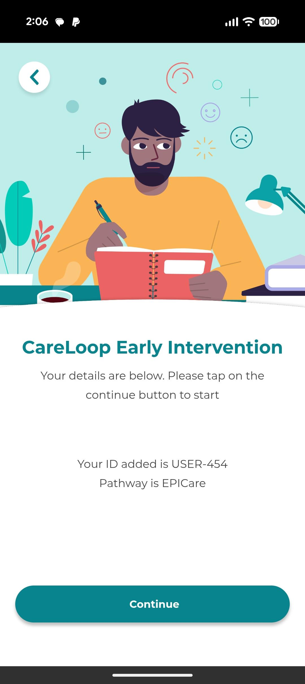

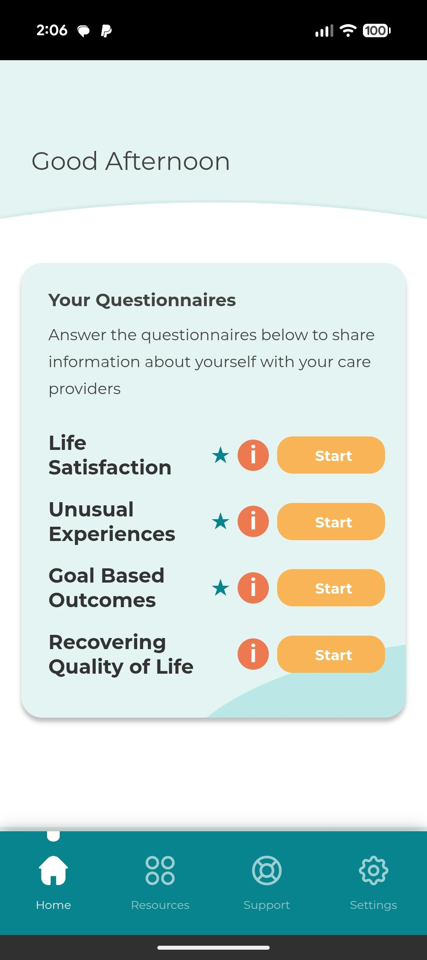
Anything you’ve configured on the backend is automatically set up ready for the Service User.

Slide 42
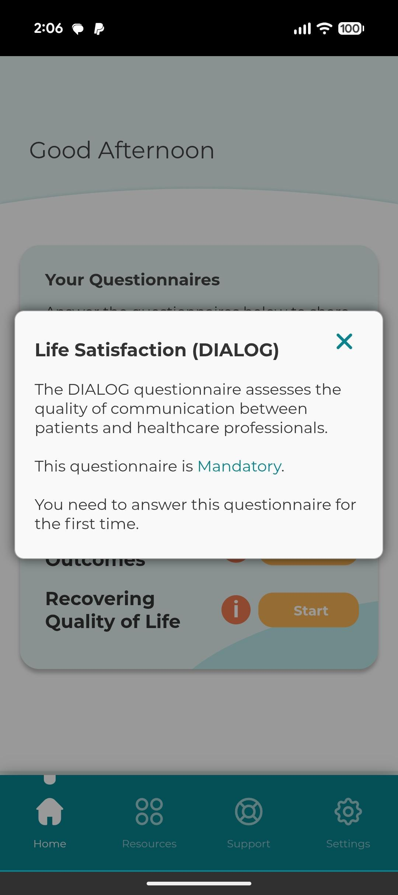
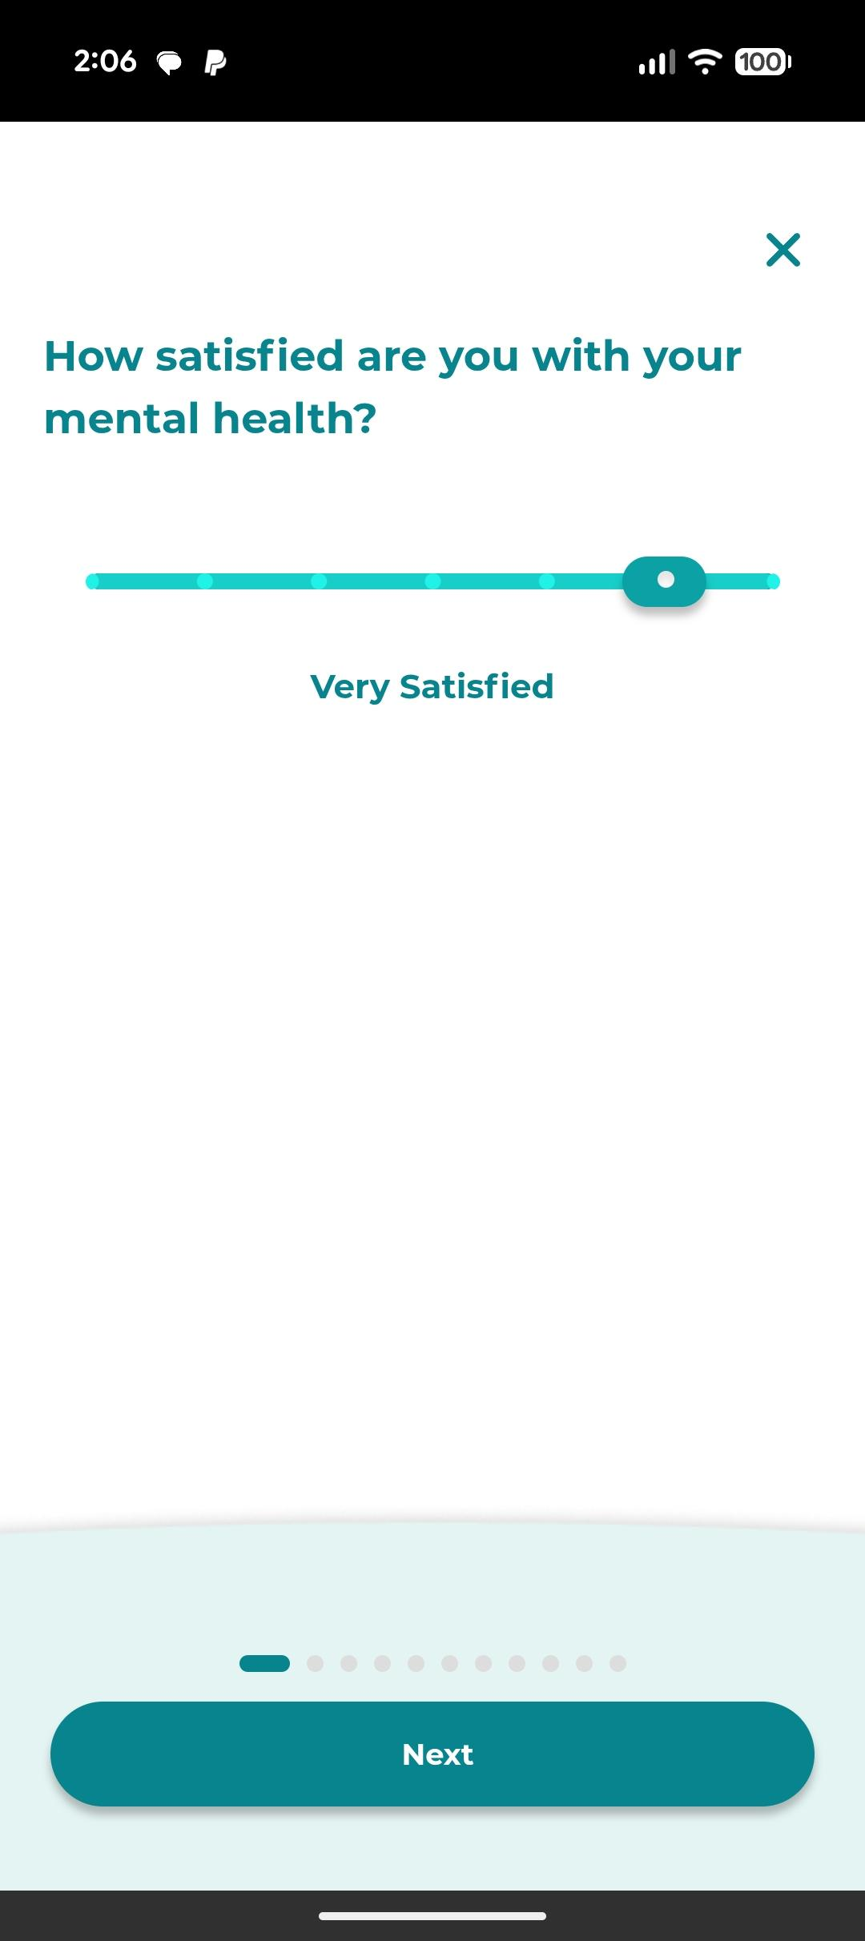
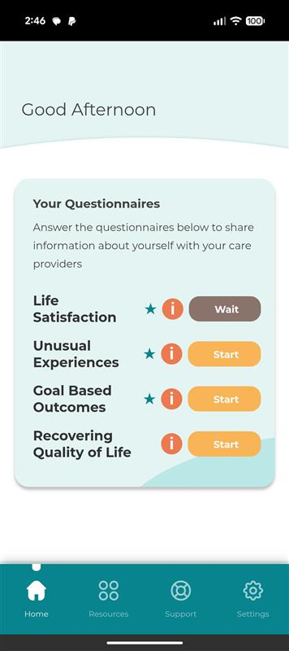
The Service User answers the questionnaires. When complete it’s sent via our servers into RiO, appearing on the relevant graph you saw earlier. The questionnaires are surfaced in the app at the appropriate time intervals. Completing the data cycle.

Slide 43
The data has now populated the relevant graph for the Service User within the RiO system.

Slide 44
11:40–11:45 Clinical perspective (Zia Katshu)

Slide 45


EPICare Clinical Relevance
Mohammad Zia Ul Haq Katshu
Clinical Associate Prof & Joint Director
Centre for Translational Neurosciences for Mental Health

Slide 46
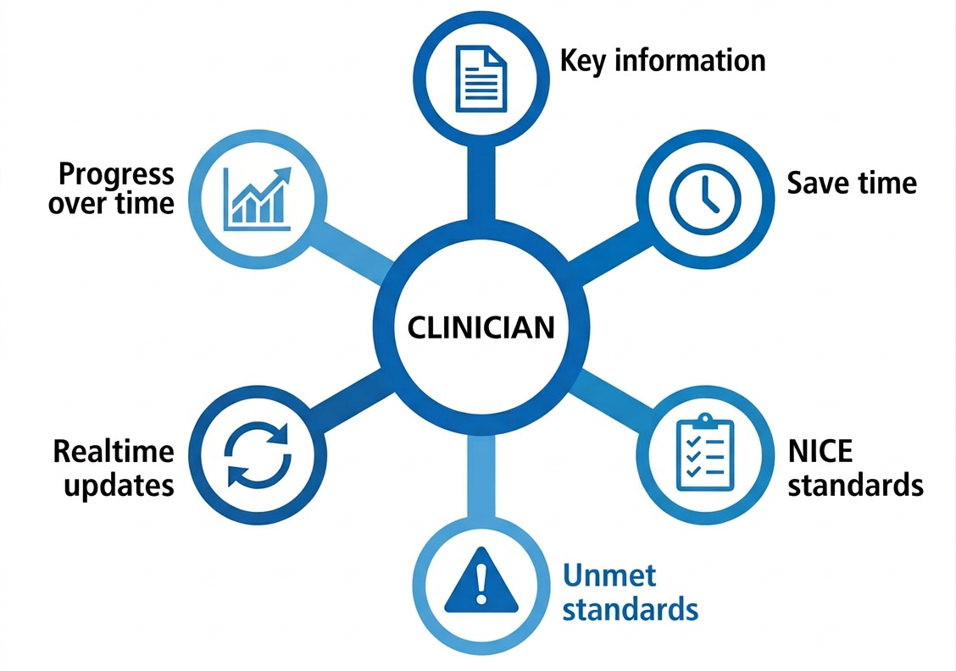
EPICare Dashboard
Notes:
Key patient information under your care
Reduce time searching through the notes
Care against NICE standards
Highlight unmet standards
Realtime updates
Changes over time

Slide 47
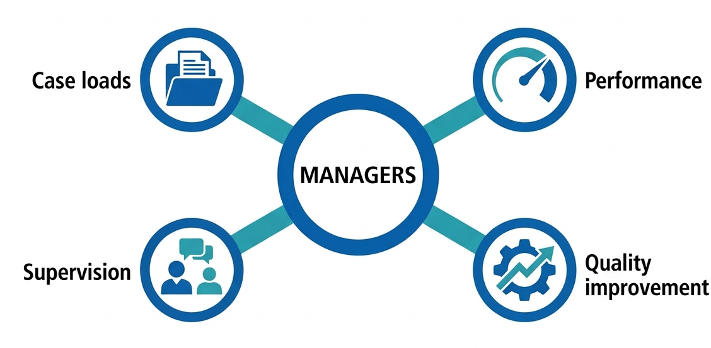
EPICare Dashboard
Notes:
Real time team case loads
Team performance against NICE standards
Evidence impact of quality improvement
Individual supervision made simple

Slide 48
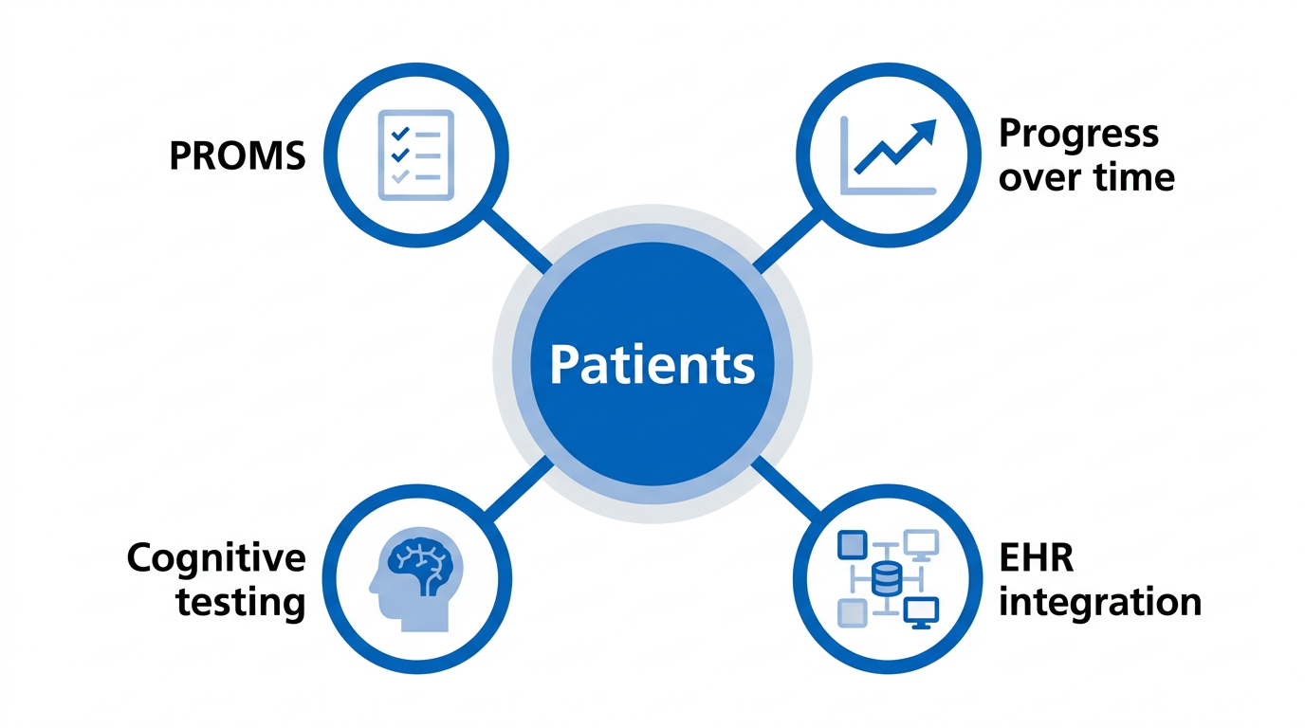
Patient interface
Notes:
PROMS more genuine reflection of patient experience (REQOL, GBO, DIALOG, PANSS)
Allows to see progress over time
Automated cognitive testing
Integration with EHR

Slide 49
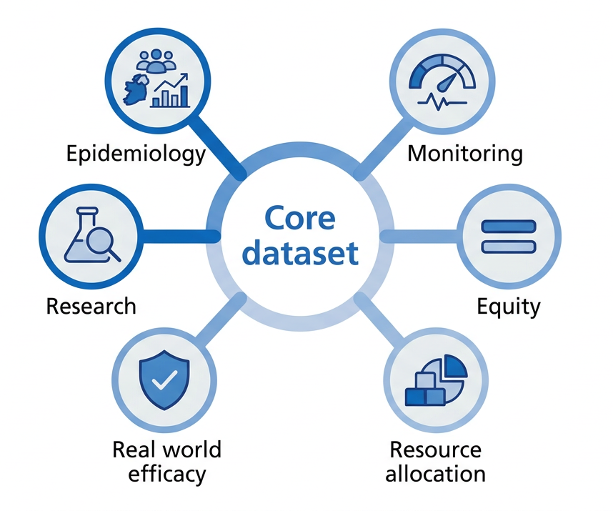
Core dataset
Notes:
Local epidemiological trends
Monitoring care across country
Equity of care
Need for resource allocation
What workers for our patients
Future research to improve our understanding of psychosis, develop better treatment approaches

Slide 50
Thank you!
Any Questions?

Slide 51
11:45–11:50 PPIE Perspectives (Sophie Allan)

Slide 52



Lived Experience in
Stage 1 (2021-22)
  10 experts by experience (not all with EIP experience)
  Online workshops integrated with clinicians, academics
    Variable feedback
    Format changed
Stage 2 (2023-25)
  8 people recruited: experience of FEP within 5 years (or as carer)
  Online meetings with EPICare team
  Activities included live software engagement and feedback, co-developing onboarding materials, advising on logo design, involvement in dissemination
Stage 3 (2026-)
  Continuing with 8 members
  Regular meetings (at least every 6 months)
  Representation on Investigator and Investigator+ meetings
  Co-producing short videos for website on EPICare and involvement to-date
  PPIE video

Slide 53
Breakout session 1:
Understanding our ecosystem (stakeholder mapping)

Slide 54
Understanding our ecosystem (30 mins)
The aim of this activity is to think about all the different stakeholders involved in EPICare, their needs, priorities & concerns, and map this out to recognise points of synergy and tension.
At your table, map out the key stakeholder groups relevant to EPICare (they may not all be represented at your table) on the poster paper provided. For each stakeholder group, add your views on the following to the poster:
What does each group care about?
What might their concerns be?
What might motivate them?
Each table will have a pre-nominated facilitator. Posters will be displayed at lunch for viewing, and we will use this information to identify areas to improve stakeholder engagement and involvement

Slide 55
Breakout session 2:
Developing our shared purpose (world café)

Slide 56
Developing our shared purpose (40 mins)
The aim of this activity is to identify common ground to help stakeholders develop a shared understanding of the EPICare platform and how they can contribute to it.
The facilitator at each table will ask three questions (10 minutes per question). After each question, participants should move to a different table (with people they haven’t sat with before, ideally) to answer question 2, and then question 3:
Q1: What should EPICare ultimately aim to achieve for the country?
Q2: What would some successful indicators of this look like? (i.e. improved recovery, higher quality data for research, fewer inequalities?)
Q3: What values should guide our collaboration to achieve this?
The facilitator will add answers to the poster.
In the last 10 minutes (stay at your final table), identify and underline the most important themes on the poster. As before, posters will be displayed for viewing at lunch, and used to inform the program after the event.

Slide 57
Lunch (1-2pm)
Participants are invited to view the EPICare dashboard demos, view the posters from the morning, and relax and chat!
Dashboard demos on Table 1 from Clement (Nottinghamshire), Ping (Cambridgeshire & Peterborough), Charles (RiO EHR version)

Slide 58
Breakout session 3:
Key issues deep-dive

Slide 59
Key issues deep dive (60 mins)
We have identified four broad themes where EPICare may face particular challenges:
1: Scientific and methodological future (Rachel Upthegrove)
2: Technology & data architecture (Charlie Stockton-Powell)
3: Public trust, governance and safety (Lowri Griffiths, Sophie Allen)
4: Clinical pathways & workforce (Graham Murray)
Participants are free to join the breakout group of most interest to them. Guided by the facilitator, the group will be asked to think about the main issues they feel may affect the theme under discussion, and suggest any possible solutions to overcome this.
We hope these breakout sessions allow participants to contribute their views, concerns, suggestions and solutions to guide the EPICare programme’s future development.
We will have a notetaker at each table to take notes of key points which will be fed back to the EPICare team.

Slide 60
Break
(3-3.15pm)

Slide 61
Plenary talks - From hospital to community, and sickness to prevention

Slide 62
From Hospital to Community:
Dr Alison Brabban, National Clinical Advisor – Adult Mental Health, NHS England

Slide 63
From Sickness to Prevention: The Social Determinants of Psychosis.
Prof James Kirkbride, Division of Psychiatry, UCL

Slide 64
Reflections & next steps

Slide 65

Brief activity
Returning to mentimeter, we’d like you to answer a final simple question “What one word describes how you’re leaving today?”
www.menti.com/alqg8jixzg59

Slide 66
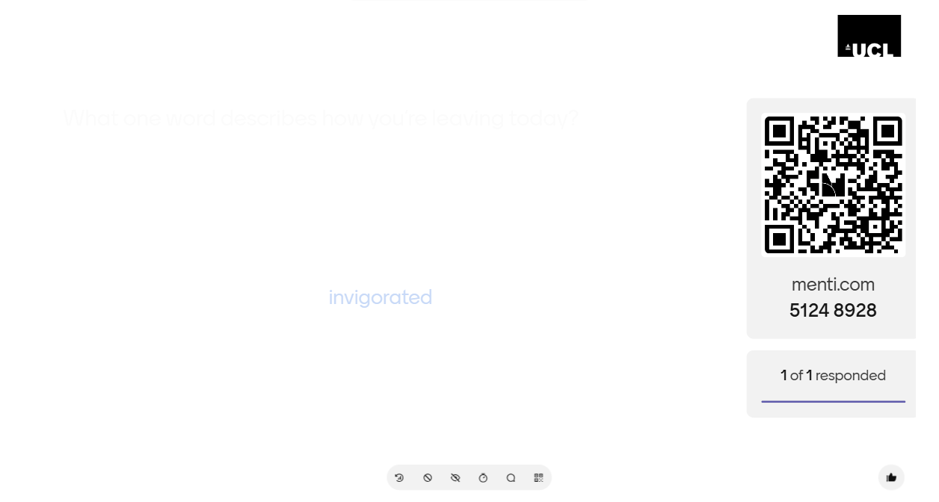
Brief activity
Returning to mentimeter, we’d like you to answer a final simple question “What one word describes how you’re leaving today?”

Slide 67
Thank you to everyone for attending and participating
We look forward to our next Investigator+ meeting in 2027
Stay in touch:
feedback@epicaremh.org
www.epicaremh.org

