Slide 1


From sickness to prevention: the social determinants of psychosis
James B. Kirkbride PhD
Professor of Psychiatric & Social Epidemiology
UCL, London, UK

Slide 2



Three messages
Consistent Evidence
Social Justice
Causation
There is now consistent evidence that social determinants are associated with psychotic disorders, as well as many other mental health conditions.
These determinants create societal inequalities, making this a core issue of social justice.
We need to strengthen the evidence by providing greater causal insights into social inequalities in mental health.

Slide 3
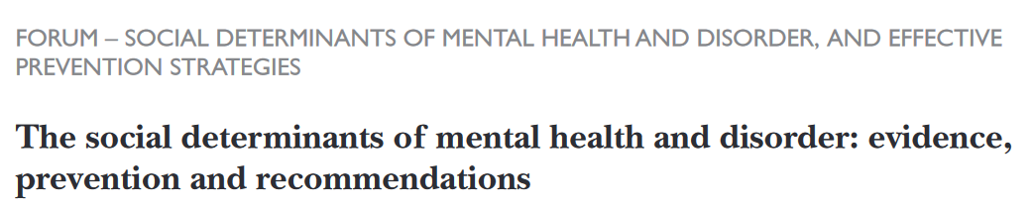

N=19,909 words + 8 discussion papers. Too Long; Didn’t Read? (TL;DR?)
Notes:
After N: In this 45 minutes plenary, that’s 442 words per minute or 7 words per second. Too long, didn’t read? Well, you’re in the right place. Over the next 45 minutes I’m going to summarise some of the highlights, evidence, recommendations and challenges from that forum piece. Sit tight!

Slide 4
Social determinants of mental health
“
Encompass the set of structural conditions to which people are exposed across the life course that affect individual mental health outcomes & contribute to…disparities within & between populations.
”
Kirkbride et al. 2024. World Psychiatry.

Slide 5

Systemic, structural and institutional forces
…the silent hand that guides exposure to #SDoMH
Social determinants are “shaped by the distribution of money, power, and resources at various levels.”
This is influenced by policy choices and the systems, structures & institutes we create.
These systems produce and reproduce intergenerational inequalities in exposure to #SDoMH.
Subsequent disparities in mental health outcomes are a critical issues of social justice.
World Health Organisation. 2024.
Notes:
First bullet: Exposure to protective and risk generating social determinants are “shaped by…”
Read remaining bullets
Then: Thus, the structures, systems, and institutes through which our lives are played out become legitimate targets for public mental health intervention.
We will return to these issues later in the talk (nb policy evaluation work)

Slide 6




Seven recommendations to improve public mental health
Social justice
Make social justice central to all public mental health interventions to ensure fair and equitable access to resources.
Multi-domain
Invest in interventions that pay off in multiple domains of health and society to maximize the benefits across various aspects of individuals' lives.
Intergenerational
Interrupt intergenerational transmission of inequalities in mental health by targeting critical windows of the life course.
Tackle poverty
Prioritize poverty alleviation interventions to address a root cause of mental health disparities.
Kirkbride et al. 2024. World Psychiatry.

Slide 7


5
6
7
Parity of Esteem
Ensure equitable resourcing of primary prevention in mental health to match secondary and tertiary investment.
Improve Surveillance
Develop accurate and inclusive systems for population mental health monitoring to enhance data quality and equitable policy-making.
Identify causes
Strengthen causal inference in social determinants of mental health by improving statistical methods and conducting interdisciplinary research.
Kirkbride et al. 2024. World Psychiatry.

Slide 8
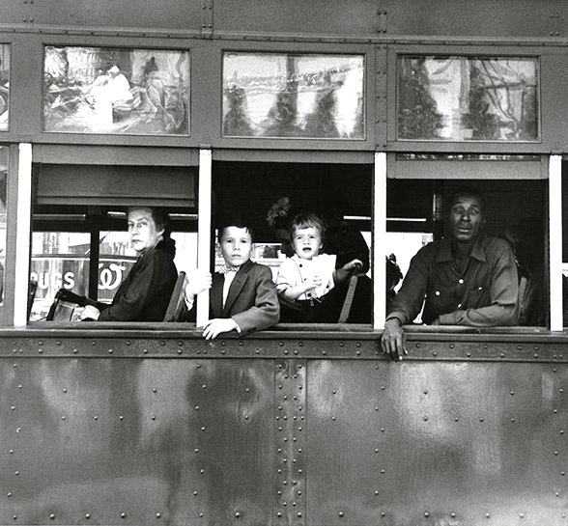

Two examples on psychosis prevention
1
2
Ethnicity, discrimination & psychosis
Social capital, ethnicity & psychosis
Advancing causal inference on the benefits and harms of social capital on psychosis risk
Discovering modifiable social determinants to address ethnic disparities in psychosis risk

Slide 9
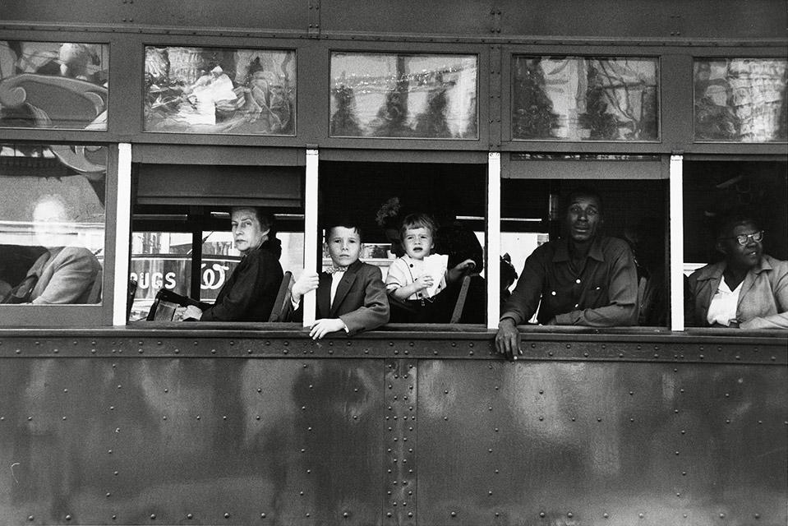
Ethnicity, discrimination & psychosis.
1
Robert Frank / The Met Gilman Collection
Notes:
(Hide this slide if you use the three above in future talks)

Slide 10
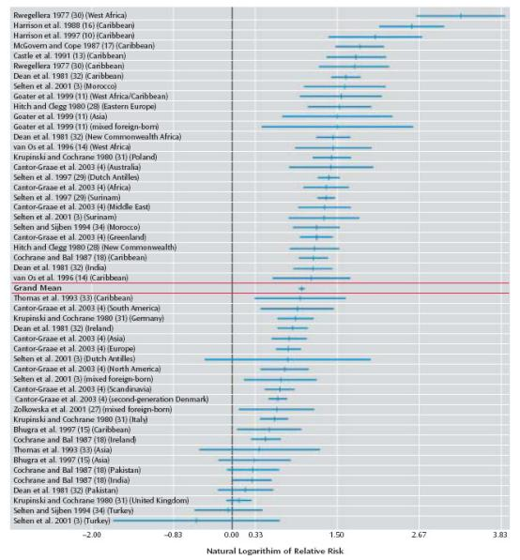
Ethnicity, discrimination & psychosis
Over a century of evidence of ethnic disparities in psychosis
Earliest reliable data from Odegaard’s (1932) seminal study of Norwegian migrants to the USA
Consistent evidence since of raised rates of psychosis in several minoritised ethnic groups
Highest rates observed for people of Black heritage, irrespective of migrant status
Previous studies have largely ruled out misdiagnosis, basic confounding (age, sex, SES), natural variation in rates, & selection as explanations of ethnic disparities
These disparities do not exist to the same extent for non-psychotic mental health conditions (with the “exception” of PTSD in refugee migrants)
Causes have remained unknown for over a century
Ethnicity per se cannot be a cause of these disparities in psychosis risk
Rather, ethnicity is a social construct to which other risk factors are structurally and culturally determined
Cantor-Graae & Selten 2005. Am J Psychiatry.
Robert Frank / The Met Gilman Collection

Slide 11
We need to move beyond studies which demonstrate excess rates to identify the… mechanisms through which this risk is shaped
“
”
Dykxhoorn & Kirkbride. 2019. Epidemiology & Psychiatric Services.

Slide 12

Social Experience and Psychosis Risk in Minoritised Ethnic Groups
Psychosocial Disempowerment
Psychosocial disempowerment – perceived feeling of loss of control and autonomy over one’s environment. Affects several health outcomes.
Marmot. 2004.
Marmot. 2006. JAMA.
Sociocultural Distance
May arise due to greater social and cultural distance from the majority group, leading to feelings of isolation, exclusion or discrimination.
Jongsma. 2021. Psychological Medicine.
Our hypothesis
Psychosis risk in ethnic minority groups would be attributable to greater sociocultural distance as a marker of psychosocial disempowerment.
Jongsma. 2021. Psychological Medicine.
Jongsma et al. (2021). Psychological Medicine

Slide 13

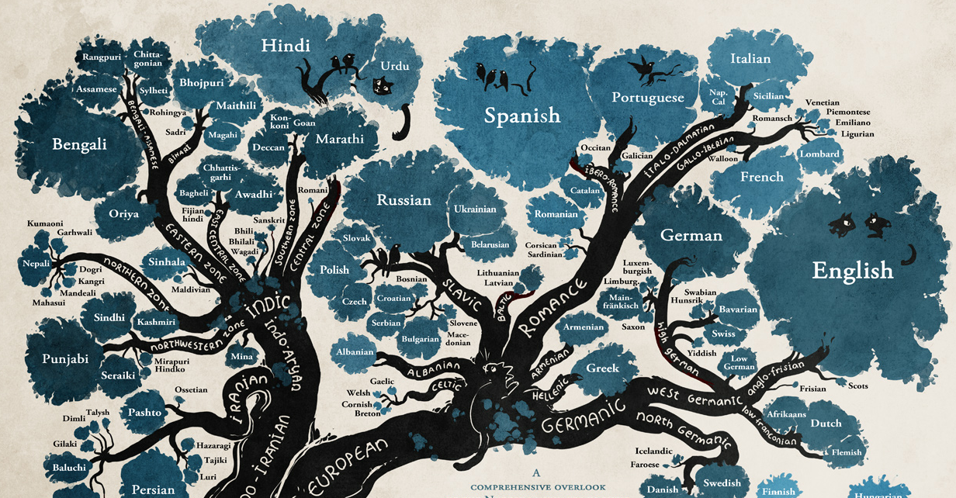
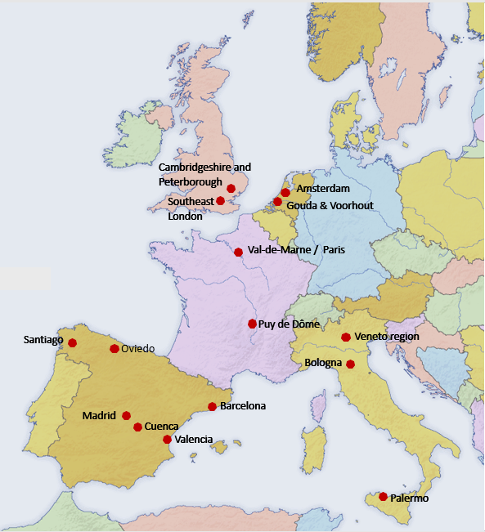
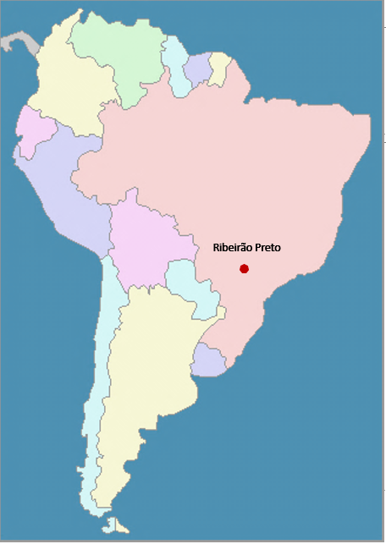
Ethnicity, discrimination & psychosis
Key Insights from Jongsma et al. 2021.
Data taken from EU-GEI case-control study
1,130 FEP cases & 1,497 controls from 17 centres
Netherlands, France, Spain, Italy, UK & Brasil
Social distance: education, parental SES, social isolation
Linguistic distance: measured via language trees & fluency
Disempowerment: discrimination
Jongsma et al. (2021). Psychological Medicine
Robert Frank / The Met Gilman Collection

Slide 14
Adjusted for: age*sex, paternal age, childhood trauma, cannabis use, parental psychosis
Patterns independently observed in black, Asian, North African & mixed ethnic groups
Adjusted for: Model 1 + social disadvantage (education, parental SES, social isolation)
Adjusted for: Model 2 + linguistic distance
Adjusted for: Model 3 + discrimination
Jongsma et al. (2021). Psychological Medicine
Robert Frank / The Met Gilman Collection
Notes:
Further work suggests it is cultural distance, not discrimination which predicts the raised rates in migrant groups
While discrimination might represent acute, perceived experiences, social and cultural distance may reflect more chronic, structural effects of discrimination deeply embedded in society

Slide 15

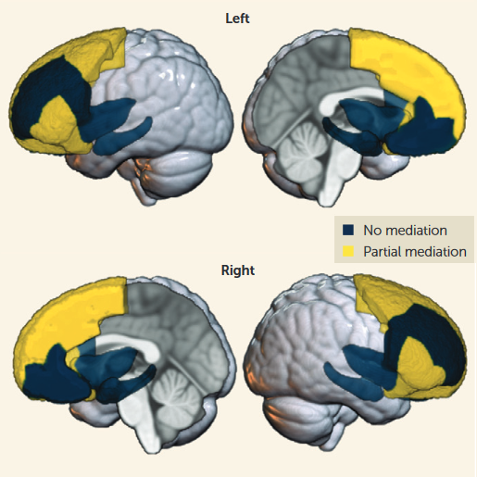
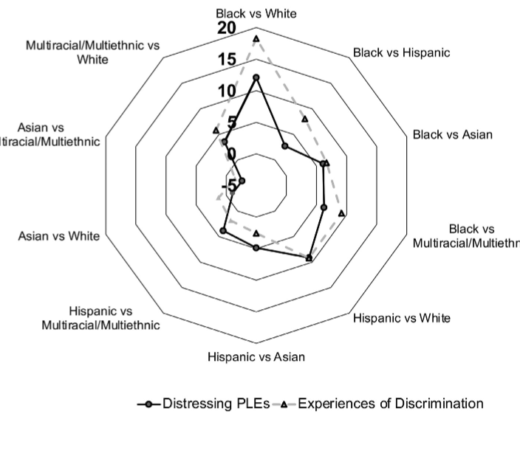
Structural racism & psychosis
Beyond direct forms of racism
Brain Volume Disparities
Psychotic-like Experiences
In the ABCD study (USA), Black children experience more traumatic events, familial conflict & material hardship than White children.
Lower brain volumes in Black children in key areas related to psychosis, including amygdala & prefrontal cortex; latter partially mediated by childhood adversity.
Black and Hispanic children reported more psychotic-like experiences; partially explained by racial discrimination.
Karcher et al. 2021. JAACAP.
Dumornay et al. 2023. Am J Psychiatr.
Dumornay et al. 2023. Am J Psychiatr.
Notes:
(Use for longer – 1 hour – only)

Slide 16

Social capital, ethnicity & psychosis.
2
Notes:
(Hide this slide if you use the three above in future talks)

Slide 17
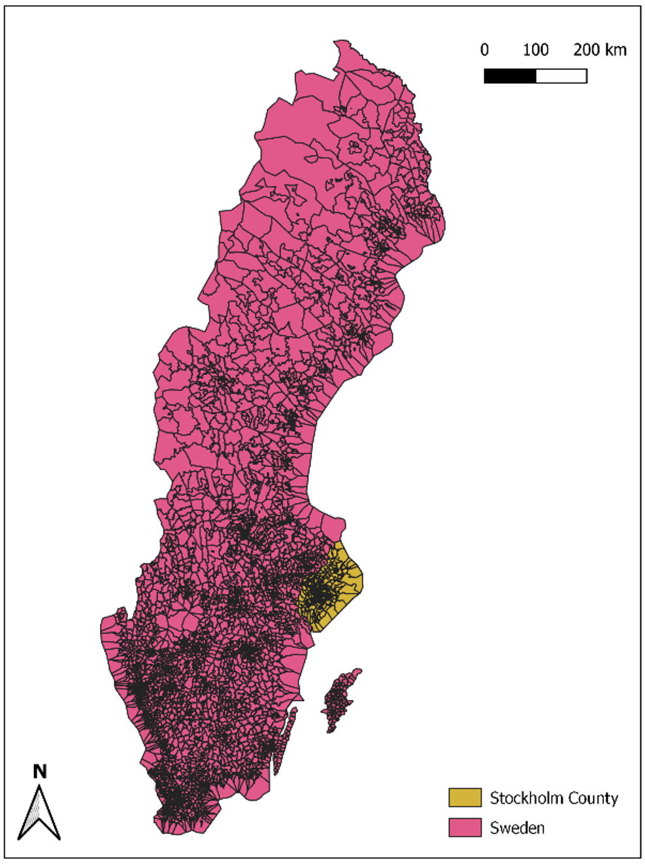
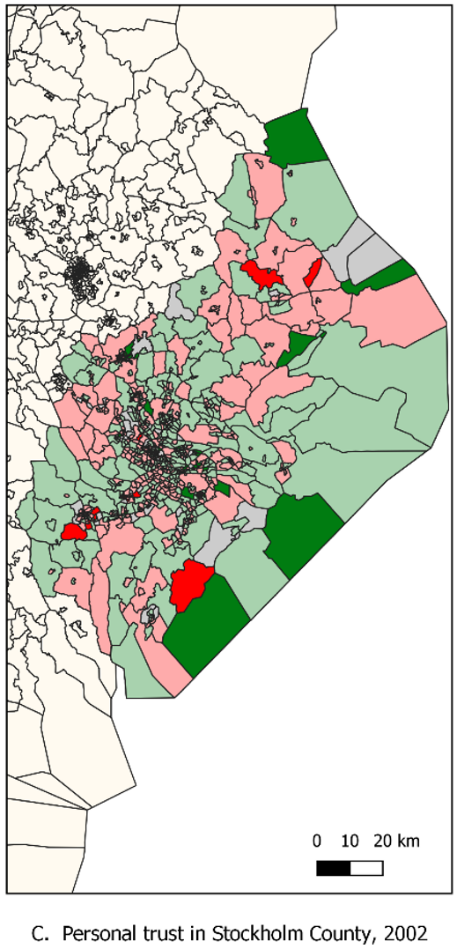

Neighbourhood social capital & psychosis risk
Key Insights from Chase et al. 2025.
Neighbourhood social capital (trust in others) rated from population survey of 23.5k in Stockholm, Sweden in 2002
72% of respondents Swedish-born; migrants 50% less likely to have taken part in survey
Therefore, social capital arguably measures how much Swedish-born population experience neighbourhood trust, not migrants
1.5m people in Stockholm followed from 2002-2016 for first episode of non-affective psychoses
Statistics: Multilevel Cox proportional hazards models with time-varying covariates including deprivation, population density. Time-fixed measures: age, sex, income, parental history of SMI, parental region-of-origin
Chase et al. (2025). Nature Mental Health
Notes:
427 of 484 (with known addresses)

Slide 18
Neighbourhood social capital & psychosis risk
Key Insights from Chase et al. 2025.
7,291 first non-affective psychosis cases in Stockholm County, 2002-16 over 14m person-years of risk
Greater social capital in 2002 associated with reduced incidence rates of non-affective psychotic disorders for Swedish-born & other European migrants
But, associated with increased incidence for some migrants
Similar patterns found for non-psychotic bipolar disorder
Suggests social capital can be both protective & harmful
Results remained using an instrumental variable approach (a method for potentially allowing stronger causal conclusions)
Chase et al. (2025). Nature Mental Health
Notes:
427 of 484 (with known addresses)

Slide 19
Conclusions
Prevention strategies depend on understanding whether social factors cause psychotic disorders
Growing evidence that ethnic disparities in psychosis risk are caused by exposure to societal, systemic and structural racism and discrimination
This suggests that we can identify novel social targets in the community (preventing discrimination, promoting inclusive social cohesion) that could prevent psychosis before it reached the clinic
Notes:
First bullet: Exposure to protective and risk generating social determinants are “shaped by…”
Read remaining bullets
Then: Thus, the structures, systems, and institutes through which our lives are played out become legitimate targets for public mental health intervention.
We will return to these issues later in the talk (nb policy evaluation work)

Slide 20
Acknowledgements
SDMH co-authors
PsyLife team
PsyLife alumni
Collaborators
Deidre M. Anglin (CUNY, USA)
Ian Colman (Ottawa University, Canada)
Jennifer Dykxhoorn (UCL, UK)
Peter B. Jones (University of Cambridge, UK)
Praveetha Patalay (UCL, UK)
Alexandra Pitman (UCL, UK)
Emma Soneson (University of Oxford, UK)
Thomas Steare (UCL, UK)
Talen Wright (UCL, UK)
Lowri Griffiths (University of Birmingham, UK)
Annie Jeffery
Nat Rich
India Francis-Crossley
Georgie Hudson
Alua Yeskendir
Humma Andleeb
(Work presented in talk)
Francesca Solmi
Hannah Jongsma (PhD alum.)
Jen Dykxhoorn (PhD alum.)
Vera Brink (PhD visitor)
Angela Chase (M.Sc. alum.)
Keltie McDonald
Jean Stafford (PhD alum.)
Tao Ding
Gemma Lewis
Ka-Young Ban (PhD alum.)
Sam Harris (M.Sc. alum.)
Prof. Gianluca Baio (UCL)
Prof Peter Jones (University of Cambridge)
Prof Craig Morgan (KCL)
Prof. Christina Dalman (KI)
Prof. Cecilia Magnusson (KI)
Dr Anna-Clara Hollander (KI)
Contact:
j.kirkbride@ucl.ac.uk
www.psylife.eu
LinkedIn.com/ProfKirkbride

